Slide 1
A READING FrOM the
Book of job
38:1, 8-11
Notes:
This and following for the first reading

Slide 2
The Lord addressed Job out of the storm and said: Who shut within doors the sea, when it burst forth from the womb; when I made the clouds its garment and thick darkness its swaddling bands? When I set limits for it and fastened the bar of its door, and said: Thus far shall you come but no farther, and here shall your proud waves be stilled!

Slide 3
The word of the Lord.
Thanks be to God.

Slide 4
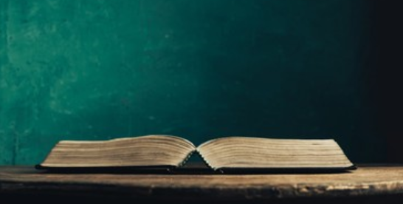
Notes:
Filler between 1st Reading and Responsorial Psalm.

Slide 5
RESPONSORIAL PSALM
Psalm 107:23-24, 25-26, 28-29, 30-31
V:
Give thanks to the Lord, his love is everlasting.
R:
Give thanks to the Lord, his love is everlasting.
Notes:
This and following for Responsorial Psalm.

Slide 6
They who sailed the sea in ships, trading on the deep waters, These saw the works of the LORD and his wonders in the abyss.
R:
Give thanks to the Lord, his love is everlasting.

Slide 7
His command raised up a storm wind which tossed its waves on high. They mounted up to heaven; they sank to the depths; their hearts melted away in their plight.
R:
Give thanks to the Lord, his love is everlasting.

Slide 8
They cried to the LORD in their distress; from their straits he rescued them, He hushed the storm to a gentle breeze, and the billows of the sea were stilled.
R:
Give thanks to the Lord, his love is everlasting.

Slide 9
They rejoiced that they were calmed, and he brought them to their desired haven. Let them give thanks to the LORD for his kindness and his wondrous deeds to the children of men.
R:
Give thanks to the Lord, his love is everlasting.

Slide 10
Notes:
Filler between Responsorial Psalm and 2nd Reading.

Slide 11
A READING from the second
Letter of st. paul to the corinthians
5:14-17
Notes:
This and following for 2nd reading.

Slide 12
Brothers and sisters: The love of Christ impels us, once we have come to the conviction that one died for all; therefore, all have died. He indeed died for all, so that those who live might no longer live for themselves but for him who for their sake died and was raised.
Consequently, from now on we regard no one according to the flesh; even if we once knew Christ according to the flesh, yet now we know him so no longer. So whoever is in Christ is a new creation: the old things have passed away; behold, new things have come.

Slide 13
The word of the Lord.
Thanks be to God.

Slide 14
Notes:
Filler between 2nd Reading and Gospel Acclamation

Slide 15
GOSPEL Acclamation
All (2x): Alleluia, alleluia, alleluia
Cantor:
A great prophet has risen in our midst God has visited his people.
All (2x): Alleluia, alleluia, alleluia
Notes:
Gospel Acclamation (alleluia)

Slide 16
Notes:
Filler between Gospel Acclamation (alleluia) and Gospel.

Slide 17
A Reading from the holy gospel
according to mark
4:35-41
Notes:
This and following for Gospel.

Slide 18
On that day, as evening drew on, Jesus said to his disciples: “Let us cross to the other side.” Leaving the crowd, they took Jesus with them in the boat just as he was. And other boats were with him. A violent squall came up and waves were breaking over the boat, so that it was already filling up. Jesus was in the stern, asleep on a cushion. They woke him and said to him, “Teacher, do you not care that we are perishing?” He woke up, rebuked the wind, and said to the sea, “Quiet! Be still!” The wind ceased and there was great calm. Then he asked them, “Why are you terrified? Do you not yet have faith?” They were filled with great awe and said to one another, “Who then is this whom even wind and sea obey?”

Slide 19
The Gospel of the Lord.
Praise to you Lord, Jesus Christ.

Slide 20
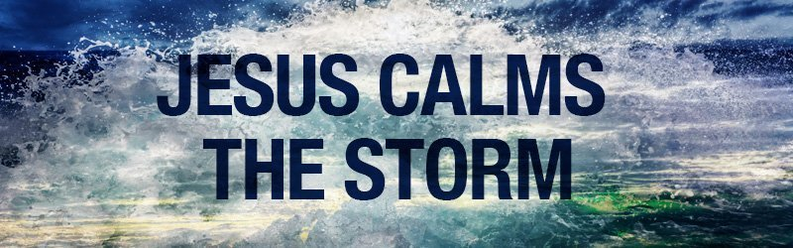
Notes:
For homily.

Slide 21

Our parish’s monthly Patriotic Rosary is switching its platform from Facebook to ZOOM! So, please join us on ZOOM in praying the Patriotic Rosary for our nation, in the month of our nation’s Independence Day celebration, on Tuesday, July 2nd at 8:00 pm! Please see the bulletin announcement for more details!

